Slide 1
Citizenship Images Activity
SS.7.C.2.1
This resource series was developed in partnership between the Lou Frey Institute, FL Joint Center for Citizenship & Orange County Public Schools, with generous funding from the Elizabeth Morse Genius Foundation.

Slide 2
Image 1

Slide 3
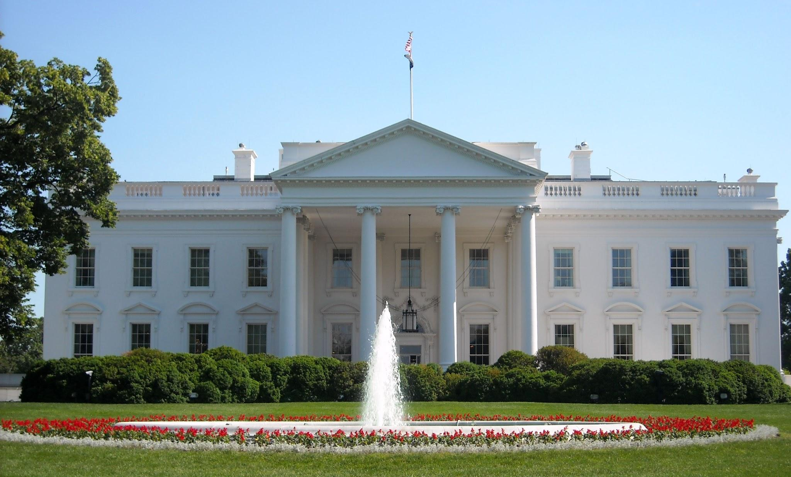
Image 2

Slide 4
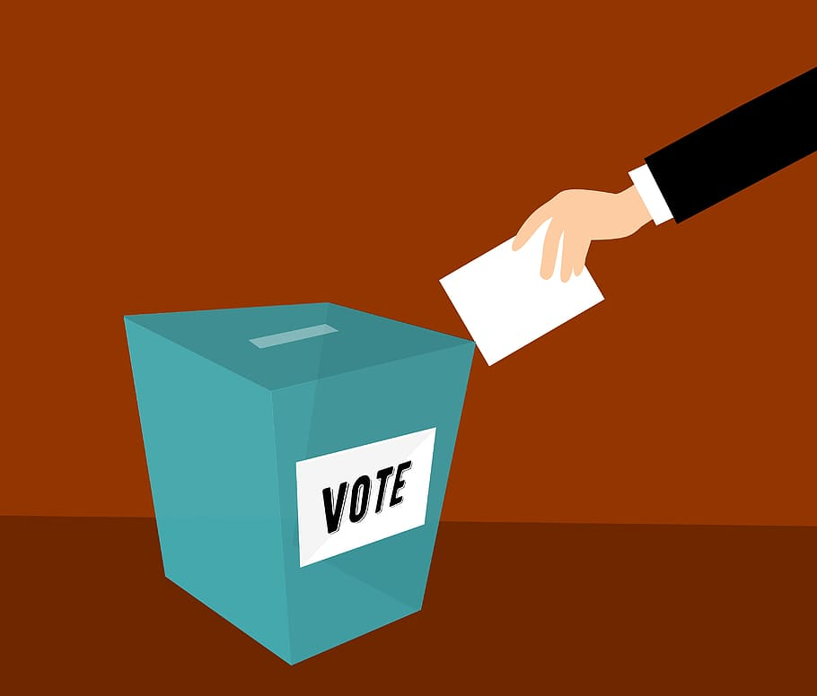
Image 3

Slide 5
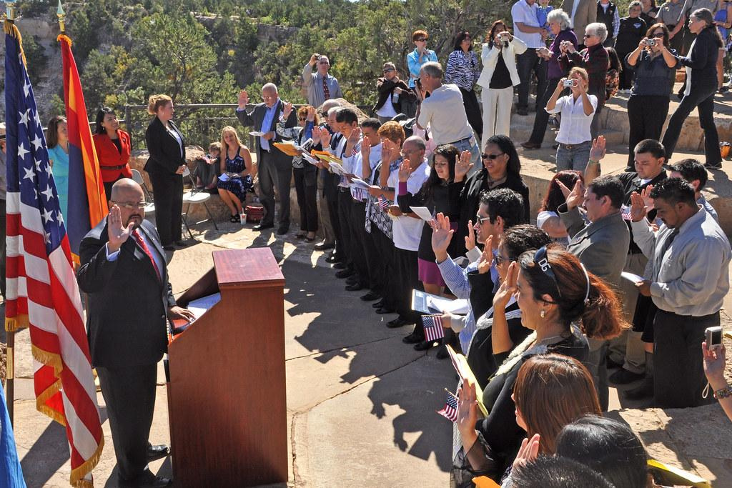
Image 4

Slide 6
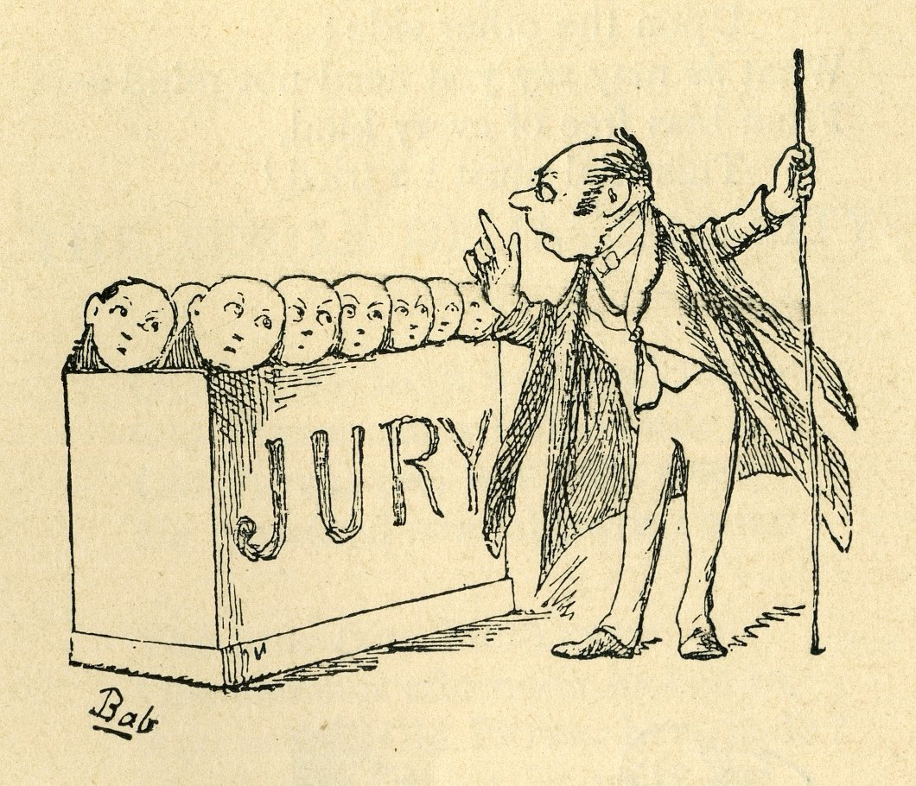
Image 5

Slide 7
Image 6

Slide 8
Image 7

Slide 9
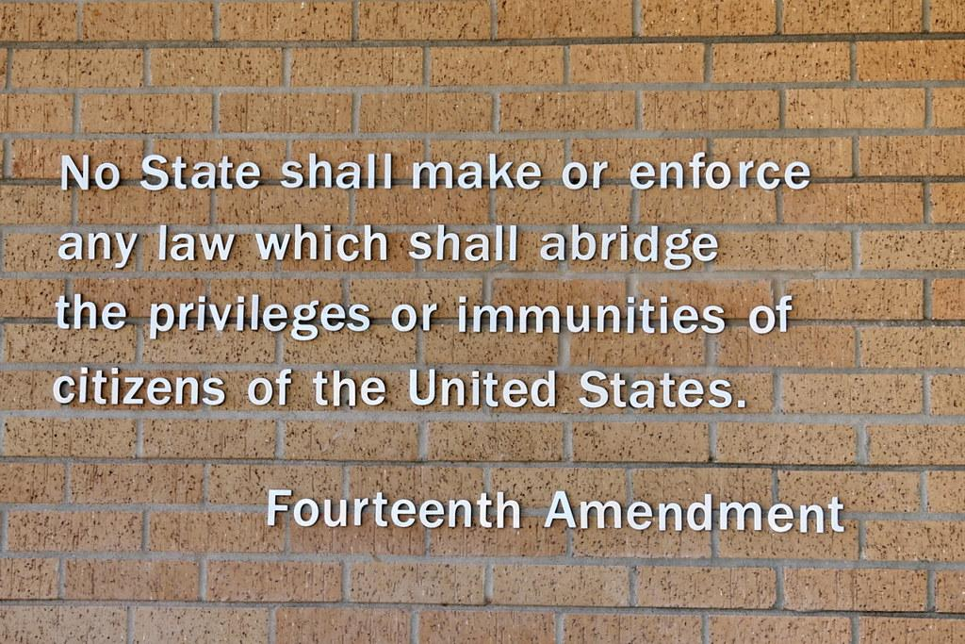
Image 8

